Slide 1
Data Report Assignment
Student Academic Data Analysis
Learning Enterprise
Sushmitha Alagesan
Asu Id: 1223040819
Ph: 623-703-7118

Slide 2
Motivation
How can analyzing student academic data help improve student outcomes?
What factors could be identified through data analysis that could impact student performance?
In what ways can data analysis assist educators in determining the efficacy of educational programs or interventions?
How can data analysis findings be communicated to educators and administrators in a way that is both understandable and actionable?

Slide 3

Objective
The objective of analyzing student academic data is to gain insights into factors that impact student performance, evaluate the effectiveness of educational programs and interventions, identify trends in course enrollment and completion rates, assess the success of partnerships with external organizations or institutions, and track student progress over time.
Through this analysis I can inform evidence-based decision-making for educators, administrators, and researchers.
The ultimate goal of data analysis is to improve student outcomes and inform the development of effective and equitable educational policies and practices.

Slide 4
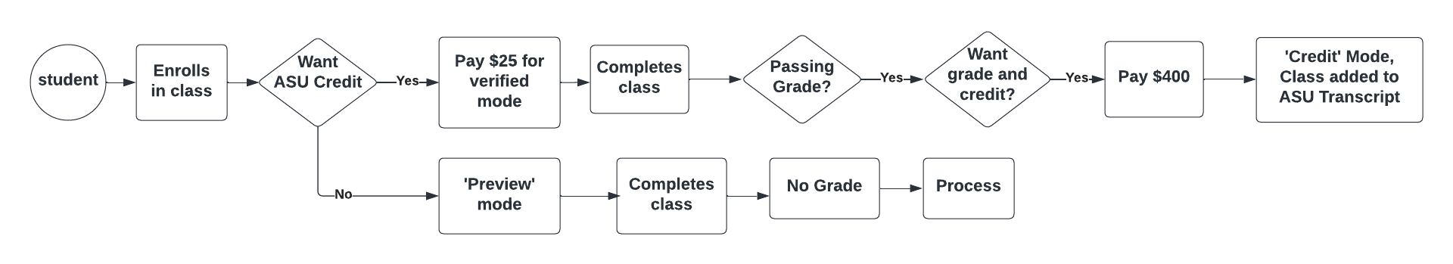
Data Exploration Outline

Slide 5
Analysis Performed
Course Participation Analysis
Course Performance Analysis
Partnership Analysis
Temporal Analysis
Enrollment Analysis

Slide 6
Course Participation
Course participation analysis involves examining the frequency and quality of a student's participation in a particular course and can provide valuable insights into student performance and engagement.
Purpose: Identifying at-risk students, Evaluating teaching strategies, Providing feedback to students, Improving course design.
Queries:
How many students have been enrolled in a particular course ?
In which term highest number of enrollments have been done ?
Which course has highest participation ?

Slide 7
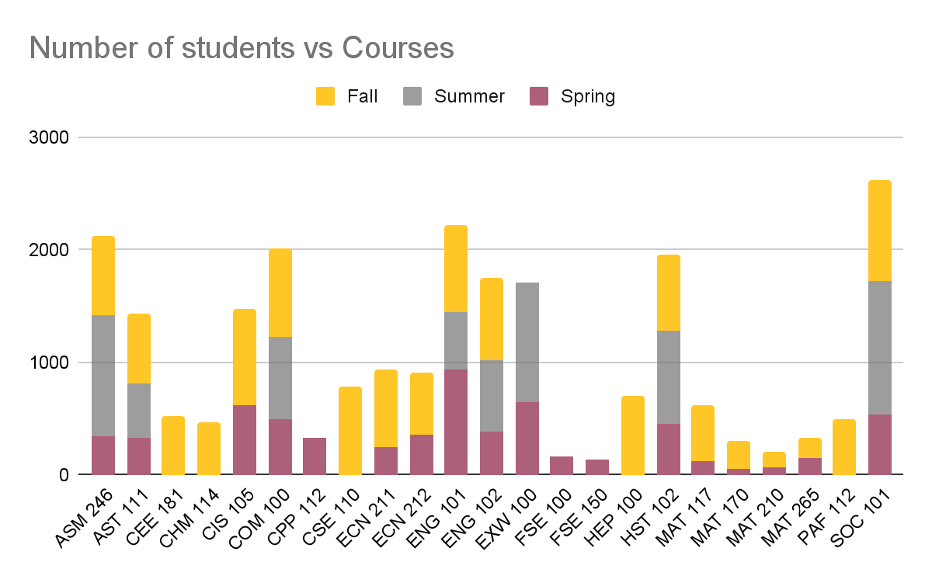
Course Participation Chart

Slide 8
Course Participation Analysis
High number of students have been enrolled for the course SOC 101.
The least most enrolled course is FSE 150.
The courses that has been enrolled by the students only for spring semester are FSE 100, FSE 150, CPP 122.
The courses that has been enrolled by the students only for Fall semester are CEE 181, CHM 114, PAF 112.
When compared with spring, summer and fall semester more number of students are enrolled in fall (twice the amount) - can we come to this conclusion ?
NO - This is due to the availability of courses that has been opened for enrollment. As more courses are opened in fall there are more enrollments in fall term

Slide 9
Course Performance
Course performance analysis involves examining a student's grades, final grade, and other related academic indicators to evaluate their performance in a particular course.
Purpose: Monitoring program effectiveness,Supporting evidence-based decision-making,Improving course design
Queries:
Which courses are most challenging for students, and why?
How can course performance analysis data be used to inform program evaluation and resource allocation decisions?
Which students are most at risk of falling behind in particular courses, and how can they be supported?

Slide 10
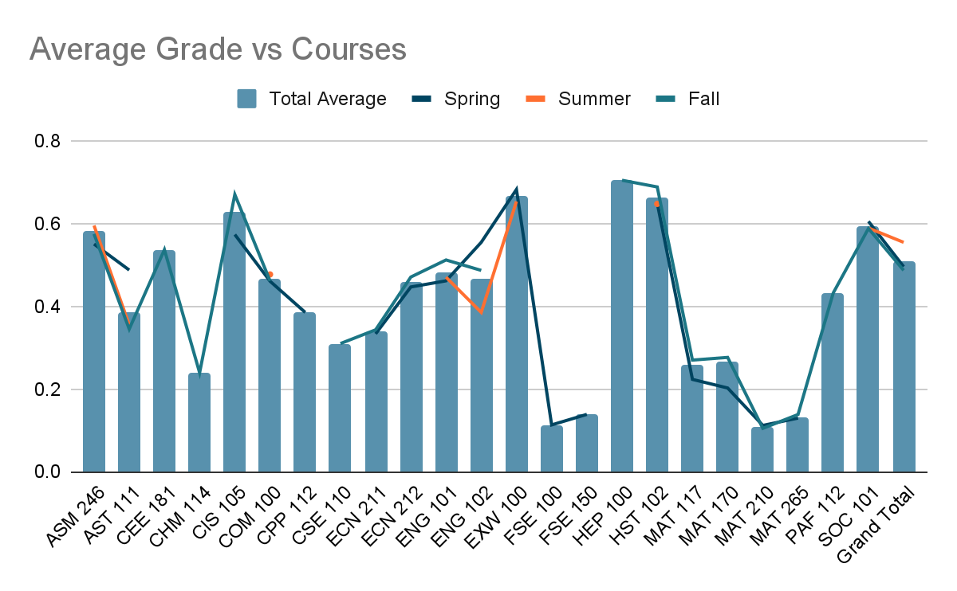
Course Performance Chart

Slide 11
Course Performance Analysis
The highest scored course is HEP 100 with average grade score of about 0.70 then EXW 100 with average grade score of about 0.664 and HST 102 with average grade score of about 0.661
The courses that has been enrolled in summer have good score when compare to other terms with an average grade score ranging between 0.35 to 0.65 and the students average score does not fall below 0.35
The potential reason would be that during summer the students will have minimal work as much courses have not been enrolled so they would be concentrating more on the subjects on which they have enrolled .
The course is MAT 210 with average grade score of about 0.10 is the least for which the program effectiveness has to be enhanced by monitoring and course design has to be leveraged.

Slide 12
Partnership Analysis
Partnership analysis with academic data involves examining the relationship between an educational institution and external organizations or institutions, and can provide insights into the effectiveness of partnerships in supporting student learning and success.
Purpose: Evaluating partnership effectiveness, Identifying areas for improvement, Informing decision-making, Strengthening partnerships
Queries:
Which partnerships are most effective in promoting student success?
What are the characteristics of successful partnerships?
How can partnerships be improved to better support student success?

Slide 13
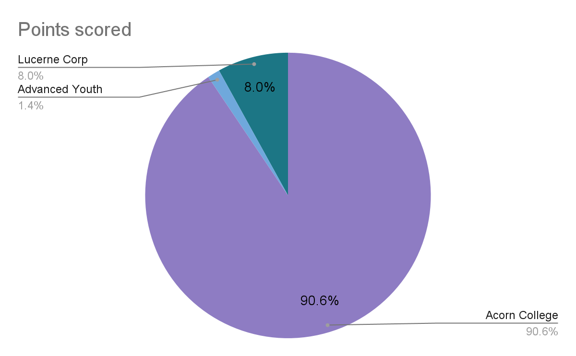
Partnership Analysis

Slide 14
Partnership Analysis
The inferences are made by analysing the partners association with students.
Highly engaged partner is Acorn College with 90.6% engagement with students.
The second most engaged partner is Lucerne Corp with 8.0% engagement with students.
The least engaged partner is Advanced youth with 1.4% engagement with students.
But the gap between the engagement of Acorn College and Lucerne Corp is very high.
So the partnership effectiveness has to be monitored with Acorn College and identify the areas for improvement with other partners to strengthen the partnerships

Slide 15
Temporal Analysis
Time series analysis of academic data involves analyzing data over time, often with the goal of identifying trends, patterns, or changes in student performance or other academic indicators.
Purpose: Identifying trends in student performance, Evaluating the effectiveness of interventions, Forecasting future performance, Identifying patterns and anomalies, Identifying patterns and anomalies
Queries:
How have student outcomes changed over time, and what factors have contributed to these changes?
How have funding levels changed over time, and what impact has this had on program outcomes?
How can time series analysis data be used to inform strategic planning efforts?

Slide 16
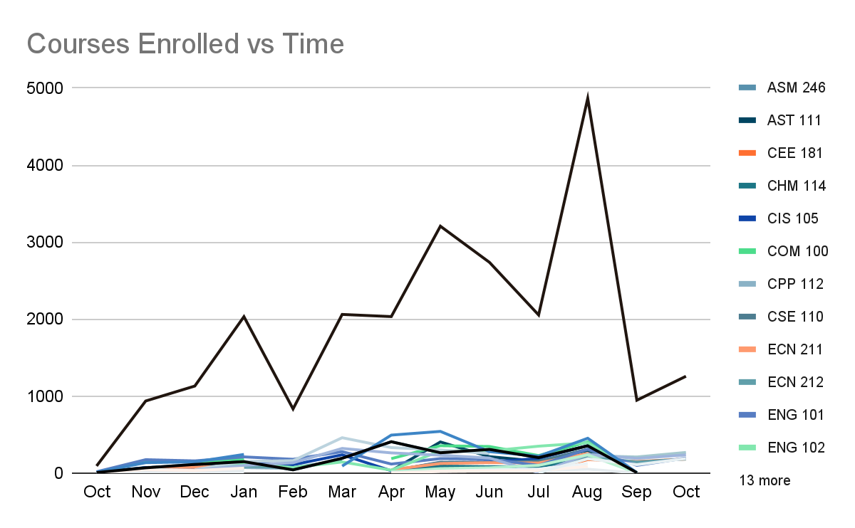
Temporal Analysis

Slide 17
Temporal Analysis
Highly enrolled course is found to be ASM 246 in the month of August and the least enrolled course ENG 102 is in the month of october.
There has been a stabilization for the course CSE 110 in the month March-April. This is because the enrollment dates are opened for the entire month.

Slide 18
Enrollment Analysis
Type of enrollment data analysis involves examining data related to how students enroll in courses, including the mode of enrollment, the timing of enrollment, and other factors that may impact student success.
Purpose: Identifying enrollment patterns, Evaluating the effectiveness of enrollment interventions, Assessing the impact of enrollment factors on student success, Informing program design, Supporting strategic planning.
Queries:
How many students are enrolling in particular courses or programs, and how does this enrollment vary over time?
How can enrollment data be used to inform resource allocation decisions?
Which courses or programs are most popular among students, and why?

Slide 19
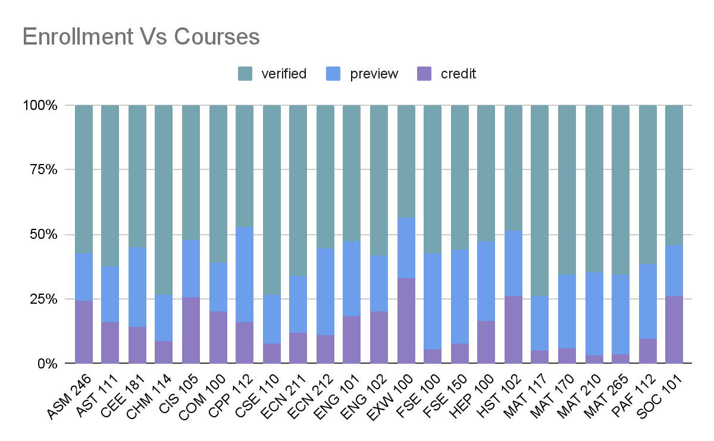
Enrollment Analysis

Slide 20
Enrollment Analysis
We can observe that not all the students those have verified will acquire preview and converted to credit. There might be many reasons for this.
The course structure might have impressed them to obtain a credit on it or it might be difficult to get not previewed .
Those courses are to be closely monitored to identify enrollment patterns and evaluate the effectiveness of enrollment interventions and assess the impact of enrollment factors on student success to inform program design

Slide 21

Thank you

